Slide 1

1
ECTE250
ENGINEERING
DESIGN
AND
MANAGEMENT
2
Winter 2025 / Spring 2025
General Information

Slide 2

Essential Subject Information
Read ECTE250 Winter 2025 / Spring 2025 Subject Outline
Read ECTE250 Project Information Booklet
Read ECTE250 Management Booklet
Read ECTE250 Moodle Announcements at
least once a week
2

Slide 3
People
Coordinator & Lecturer
Mohd Fareq Abd Malek
Email: mohamedfareqmalek@uowdubai.ac.ae
Office: Room 3.13, Level 3
Tutors
Habiba Ahmed, Eva Barbulescu, Sana Sahir, Ashna Sreejith
Emails: habibaahmed@uowdubai.ac.ae , evabarbulescu@uowdubai.ac.ae , sanasahir@uowdubai.ac.ae , ashnasreejith@uowdubai.ac.ae
Offices: Level 3
3

Slide 4
Pre/Co-requisites
◻
ENGG100 – Engineering Computing and Analysis
algorithm design and computer programming using MATLAB. Analyse engineering problems and create
algorithms that solve real-world problems. Problems solving techniques; algorithm design; data types and
operators; conditional and repetitive control flow; file access; functions; data visualisation; code
optimisation; arrays/matrices; and vectorisation.
Or CSCI191 – Engineering Programming 1
◻
◻
ECTE233 – Digital Hardware (Co-requisite)
combinational logic, simplification of logic expressions, Karnaugh maps; sequential logic, flip-flops,
registers, clock, timing and synchronization problems; sequential machines, Mealy and Moore machines,
timing diagrams and state tables; and programmable logic array and programmable logic controllers.
◻
ECTE202 – Circuits and Systems (Co-requisite)
dependent sources; circuit analysis techniques; simple operational amplifiers circuit analysis; feedback;
generalised and complex impedance; energy storage elements L, C; natural, forced and complete response
of first and second order circuits; phasors; frequency response; Bode plots; Laplace Transform and Fourier
series; and magnetically coupled circuits.
6

Slide 5
Subject Overview
◻ This subject consists of a structured team design activity covering the first
four phases of a product design cycle.
◻ Student teams will undertake the entire project using staff as 'costed'
advisors.
◻ The team activity will be supplemented
◉ project management and teamwork
◉ engineering design and prototyping
by
lectures
covering
such
areas
as:
7

Slide 6
Learning Outcomes
◻
Demonstrate an understanding of the Product Design Cycle, including the roles of those supporting
engineering design;
◻
Undertake problem identification, formulation and solution within the framework of a Product Design
Team;
◻
Function effectively in a multicultural, multidisciplinary team, with the capability to be a team
leader/manager as well as a team member;
◻
Describe a project and demonstrate an understanding of the issues affecting project management.
◻
Write structured reports and deliver organized presentations on design activities, to both peers and
customers;
◻
Perform structured, organized, and costed electronic design utilizing skills from core ECTE200-level
subjects.
8

Slide 7
ECTE250 Lectures
The lecture content covers
Introduction to the subject;
Design of basic analog and digital electronic circuits using integrated circuits and passive components;
Engineering project management and other selected material relevant to teamwork and project design.
Online lectures in project management will be provided and will be required reading for the online project management quizzes. (There will also be a project management final exam).
6

Slide 8
ECTE250 Laboratories
Laboratories are dedicated to building electronic components associated with the teams prototyped product.
Laboratories start in week 2 and are two (2) hours for every two weeks.
Starting in week 2 with the first few laboratories involve completing exercises based on the Arduino beginners guide book that comes with the Arduino kits.
An electronic copy of the book is on the moodle website
Further the projects laboratory (room 2.51 and 1.38) is available for students to work on their teams projects outside of the formal laboratories and it is expected that this will occur as needed
8
ECTE250- Engineering Design and Management 2

Slide 9
ECTE250 Project Management
Project management lectures
Several online lectures
Online Project Management Quizzes (assessed)
Project management exam (assessed)
For management lectures we will be using:
– "Project management: the managerial process", 6th edition, ERIK W LARSON, and CLIFFORD F GRAY, Beverley Honig, David Baccarini, ISBN is 9781743071809, Soft Cover, 672 pages, published 26th Sept 2013.
9

Slide 10
Assessment
◻ Marking Guidelines / Assessment Criteria for Project Deliverables are available on
the Moodle site of ECTE250.
◻ ECTE250 assessment has a 25% project management component and a 75%
engineering design and prototyping component.
◻ Minimum pass requirements
is
40% of
each component.
14

Slide 11

Classroom Rules and Policy
◻ Lectures/Laboratories
◻ The use of personal communication devices (mobile phone) is not allowed,
◉ you can use any high-tech gadgets for taking notes, and your laptop you laptop for computer-based classroom activities.
◻ No photo, audio or video recording, unless authorized.
◻ Do not leave rubbish in the classroom.
15

Slide 12
Attendance Policy
◻ Attendance is mandatory and is recorded for Laboratories.
◻ You can record/verify your attendance record on Moodle.
◻ Requirements to Pass: Lab attendance > 75%.
◻ Lecture attendance is an indicator of participation in the subject, used in determining the outcome of any
application for special consideration
◻ Excused absence requires relevant documentation submitted to the Faculty Office.
◻ Classes start and finish on time (1 academic h = 50 min + 10 min break).
◻ If you arrive late (10 minutes or more), please wait outside until the break.
◻ If need to leave the room for any reason, please wait outside until the break or end.
16

Slide 13
Lectures/Laboratories
◻ Sit/work with your teammates
◻ Ensure there is at least
required software
1 laptop
per
group
with
the
◻ Interrupt at
anytime
to
ask
questions
◻ Take notes
17

Slide 14
Required Software
◻ Multisim 12
◉ License available from Lab Engineer
◉ http://www.ni.com/download/ni-circuit-design-suite-educational-edition-12.0/2816/en/
◻ Arduino IDE
◉ Free
◉ https://www.arduino.cc/en/Main/Software
◻ Boole-Deusto
◉ Free
◉ https://weblab.deusto.es/website/boole_deusto.html
◻ MS Project
◉ Proprietary, available on all UOWD computers
◉ Available
◻ Other (optional): Eagle, Fritzing, QFSM, ….
18

Slide 15
Laboratory Safety
Max Capacity: 20 students
Tutors: Habiba Ahmed (habibaahmed@uowdubai.ac.ae)
Eva Barbulescu (evabarbulescu@uowdubai.ac.ae)
Sana Sahir (sanasahir@uowdubai.ac.ae)
Ashna Sreejith (ashnasreejith@uowdubai.ac.ae)
Engineer: Majid Munawar (majidmunawar@uowdubai.ac.ae)
SAFETY REQUIREMENTS
◻ No open shoes
◻ No uncovered legs
◻ No metal bracelets, chains, necklace
◻ No food & drinks
◻ Bags stored under the desk
Students not satisfying the requirements are not admitted in the laboratory
19

Slide 16
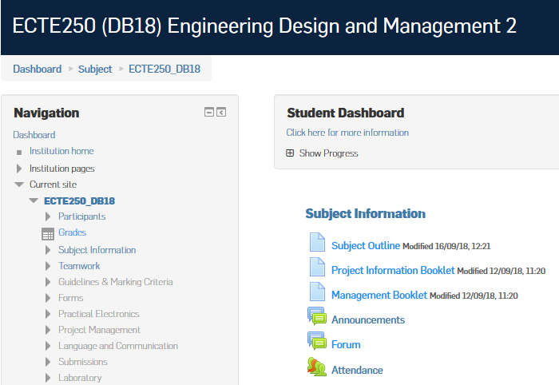
Getting and Giving Support
◻ Questions (unless strictly personal) must be
Moodle Forum.
posted
on
the
◻ Fellow
students
are
encouraged
answer.
21

Slide 17
Textbook and Readings
Textbook
◻  Project Management: the Managerial Process, 6th Edition, by Erik W Larson & Clifford F Gray, McGraw Hill
Readings
◻
Software Project Management, 3rd Ed., by Bob Hughes & Mike Cotterell.
IT Project Management On Track from Start to Finish, 3rd Ed., by Joseph Phillips. Information Technology Project Management, 6th Ed., by Kathy Schwalbe, Thomson. Design for Electrical and Computer Engineers, 1st Ed., by Ralph Ford & Chris Coulston,
McGraw-Hill.
Practical Electronics for Inventors, 3rd Ed. by Paul Scherz & Simon Monk, McGraw-Hill.
Art of Electronics, 3rd Ed., by Paul Horowitz & Winfield Hill, Cambridge.
Practical Electronics Handbook, 6th Ed, by Ian Sinclair, Elsevier.
Handmade Electronic Music: The Art of Hardware Hacking, 2nd Ed., Nicolas Collins,
Routledge.
◻
◻
◻
◻
◻
◻
◻
22

Slide 18
Project Theme & Features
◻ Structured team design activity covering the first four phases of a product
design cycle. Student teams will undertake the entire project using staff as
‘costed’ advisors
◻ Theme: IoT and their applications
The major sub-theme for this year is IoT and their applications:
- In transport and traffic management
- In health (aged care – dementia etc)
- In manufacturing industry (IR 4.0)
In humanitarian engineering (low cost engineering solutions for those needed)
Parking detection and resources sharing Systems using Electrical Systems
Electrical devices that enhance student learning in years K-12.
- Reduce, Reuse, Recycle: promote a ‘green’ behavior by minimize the negative impact of mankind on our planet (e.g. waste, pollution, energy, natural resources). The theme aims at minimum electrical power usage and maximum functionality.
- Similar IOT applications as above
As an aside IEEE has standardized some of these systems with conferences such as the world forum on the Internet of things: http://sites.ieee.org/wf-iot/
23

Slide 19
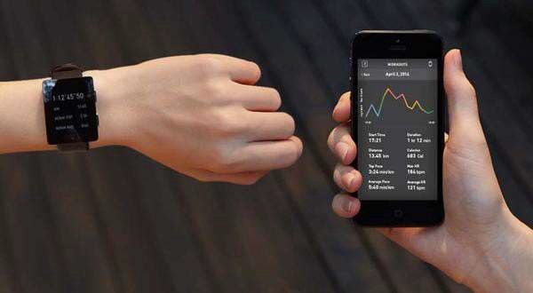
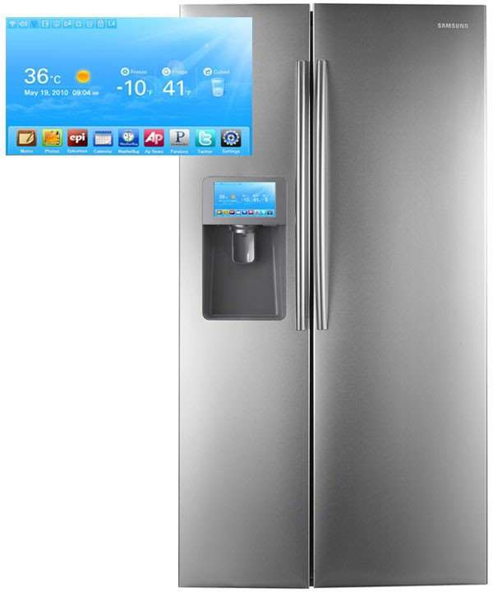





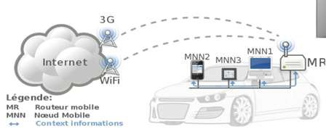

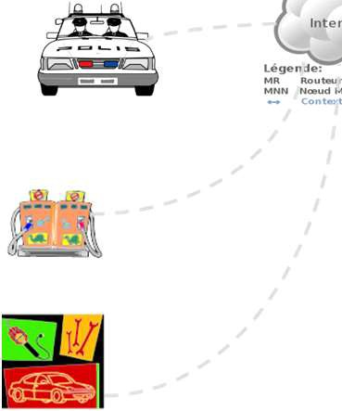
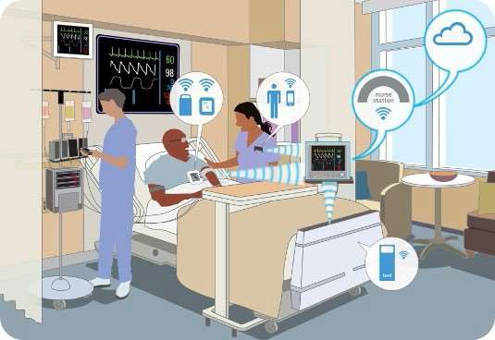

Internet of Things (IoT)
More things are being connected
People connected to things
Things are connected to things
ECG sensor
or
Internet
Motion sens

Slide 20
Internet of Things (IoT)
The Internet of Things (IoT) is the network of physical objects—devices, vehicles, buildings and other items embedded with electronics, software, sensors, and network connectivity—that enables these objects to collect and exchange data.
15

Slide 21
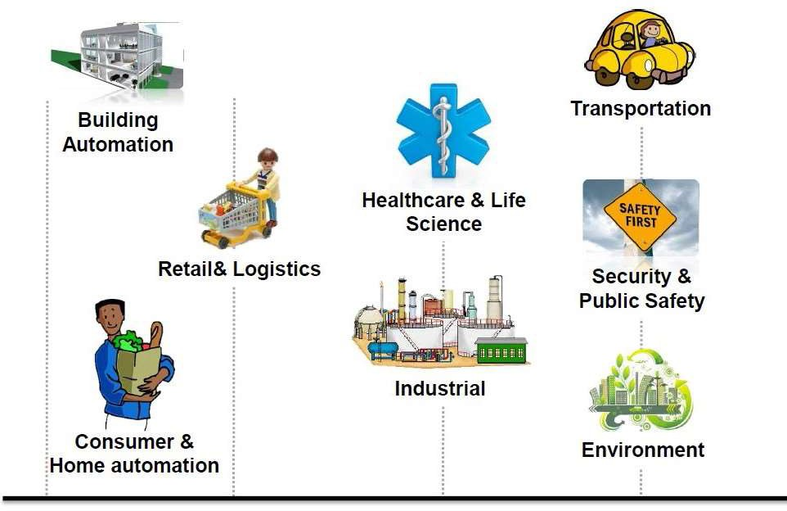

Internet of Things (IoT)
Where is IoT?
It’s everywhere!
Source

Slide 22
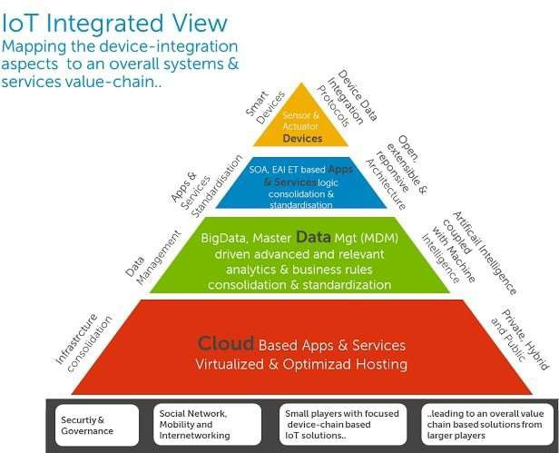
Enablers of IoT
Multiple technology achievements that enabled the rise of IoT
Hardware and software enablers
Wireless technology
Smart phones
Sensors and actuators
Big data
Source: dzone.com

Slide 23
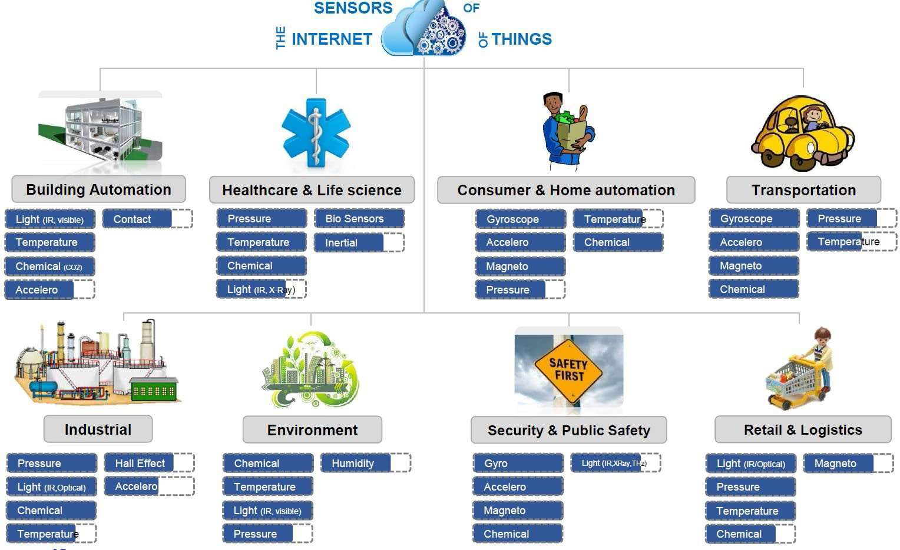

Sensors in IoT
Courtesy

Slide 24
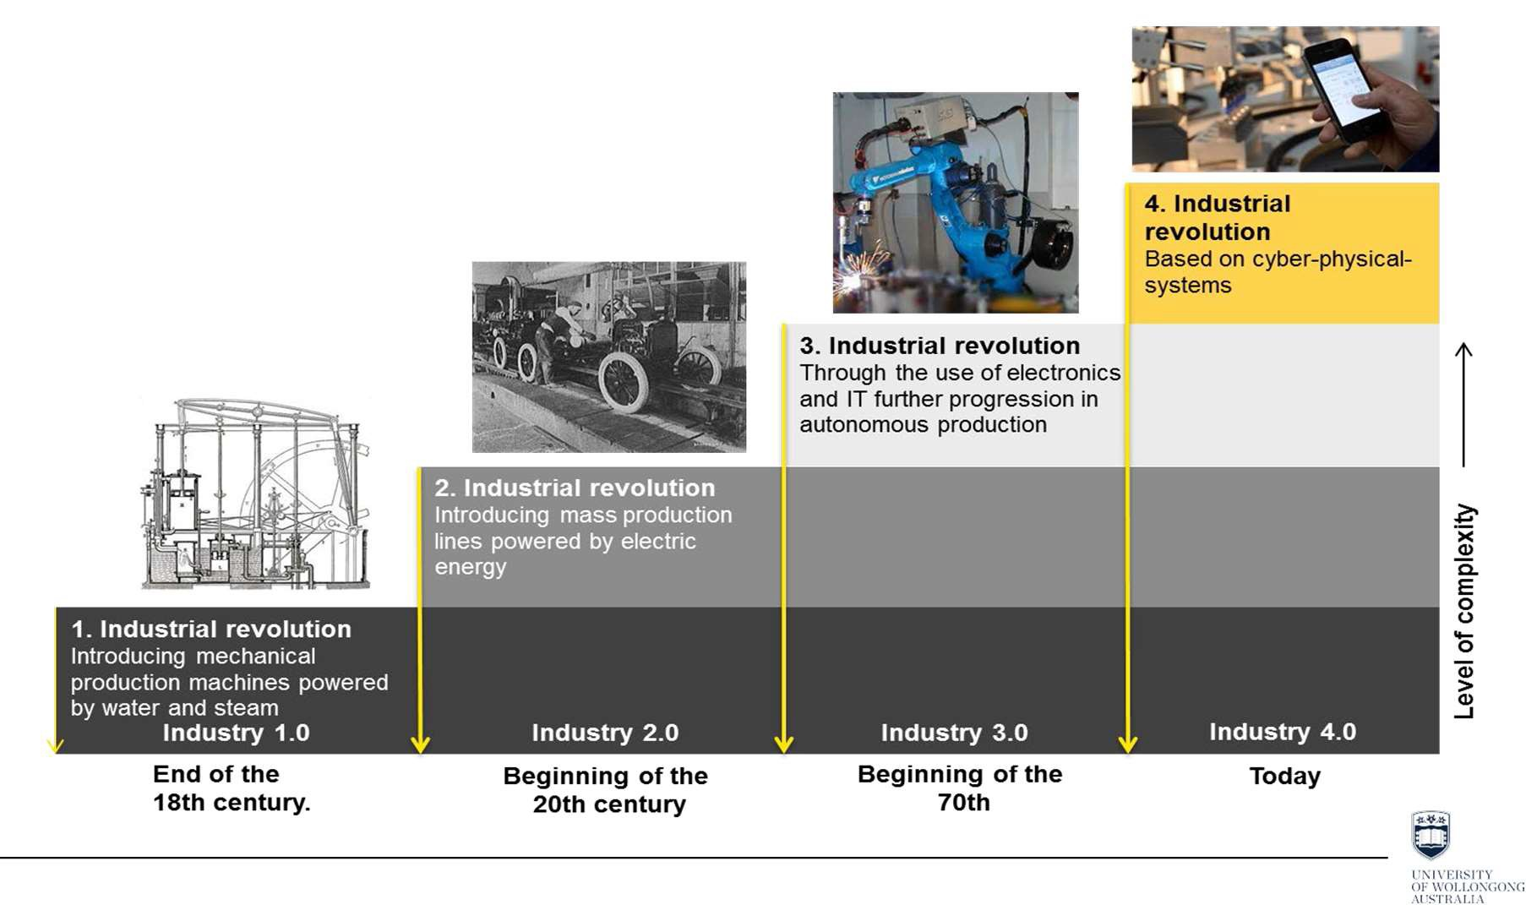
Industry 4.0
Industry 4.0 is the fourth industrial revolution, that includes automation and data exchange in manufacturing technologies.
Source: DFKI/Bauer IAO

Slide 25


UN Sustainable Development Goals and Humanitarian Engineering
20

Slide 26
Project Theme & Features
◻ Structured team design activity covering the first four phases of a product
design cycle. Student teams will undertake the entire project using staff as
‘costed’ advisors
◻ Internet of Things user-interactive system featuring
◉ State Machine (core of the system)
◉ Sensors/Input
◉ Actuators/Outputs
23

Slide 27
Teams
◻ Teams are formed by an algorithm
◻ Teams are composed by 4 or 5 students
◻ Each member have one organizational role (rotates every 4 weeks) and one
design role (fixed)
◻ Teams meet (from week 1) and report (online from Week 2) at least once
every two weeks
◻ It is strongly discourage to use social media or instant messaging systems for intra team communication. Use the discussion board on Moodle or other online platforms (e.g. Taskworld, Trello, Basecamp, JIRA, Planbox) if approved by Mentor.
25

Slide 28
Team Roles
◻ Organizational Roles (every 4 weeks)
◉ Managing Director (Chair or Team Leader)
◉ Secretary
◉ Finance
◉ Sales/Marketing
◉ Project Planning and Control including managing of WH&S requirements
◉ Quality Assurance and Sustainability
◻ Design Roles
◉ Arduino Subsystem Designer (including Network and LCD)
◉ State Machine Subsystem Designer (including clocking circuit)
◉ Sensing Subsystem Designer (including sensor circuit and ADC)
◉ Auxiliary Subsystem Designer (including power supply, motor, timer, debouncing)
26

Slide 29
Log Books & Repository
◻ Hardcopy or Soft Copy (team wise)
◉ Hardcopy: bound book, no loose sheets, signed by Tutor every 2 weeks.
◉ Softcopy: files in online repository supporting versioning shared with Mentor and Tutor
◻ Each team has:
◉ 4 Organizational Logbooks (rotating with roles)
◉ 4 Design Logbooks (personal)
◻  Logbooks summary will be provided in the online reports, and these provide the basis member's contribution to deliverables.
◻ The logbooks should be used to record all activities (and relevant minutes of meetings, etc.) of the ‘team role’ concerned.
◉ Every time you work on your project, create an entry with date and name.
◉ Do not enter summary of what you’ve done in the last week/weeks and/or personal considerations
◻ If a team member wishes to contest a mark, the logbook is a key evidence of his/her contribution.
◻ Teams are recommended to use a shared online repository for their project files.
27

Slide 30
Moodle Site
Visit ECTE250 Moodle Site weekly, it’s your key source of information!
◻ Subject Outline
◻ Project Information, Guidelines and Submission System
◻ Lectures, Handouts, Examples
◻ Laboratory Notes
◻ Attendance
◻ Teamwork
◻ Announcements & Forum (use it to ask question)
◻ Resources (readings, manuals, datasheet, tutorials, guides, etc…)
Teaching material is available well in advance, so that you can arrange ECTE250 coursework to better fit your needs.
The upload date of all files is visible, i.e. you can easily identify if you have the latest updated version (minor changes/corrections are possible close to session).
29

Slide 31
Acknowledgement
◻ Peter Vial, Stefano Fasciani, Abigail Copiaco, Kiyan Afsari
30

Slide 32
Over This Week
◻ Read
◻ Read
◻ Read
Subject Outline
Project and Management Booklets the Kit and Equipment List
◻ Explore the Moodle site of the subject
◻ Read the ‘Teamwork’ e-book on Moodle
◻ Have a first informal team meeting with your teammates to
◉ Suitable time/day for bi-weekly meeting (week 1, 3, 5, etc…)
◉ Logbooks
◉ Roles
◉ Online Repository
◉ Team laptop and software
discuss
31

